Slide 1
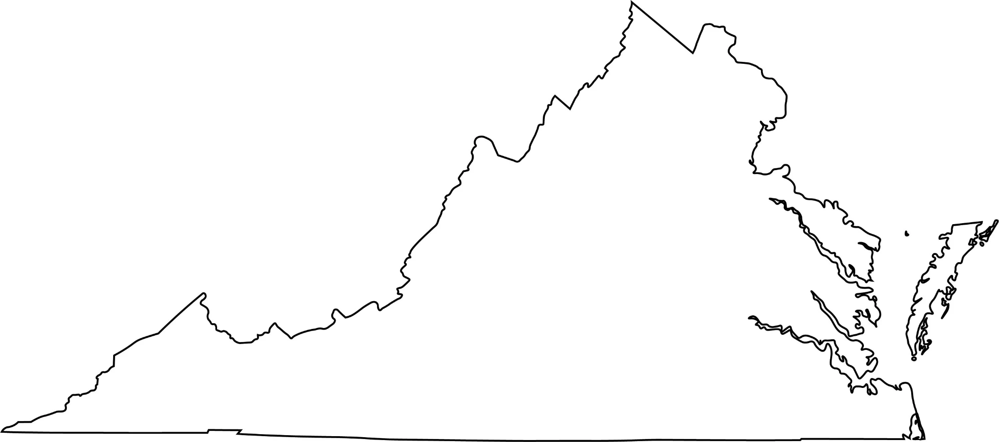
Predicting Virginia County Suitability for Carbon Dioxide Removal Techniques
Grace Davenport, Rachel Holman, Lillian Jarrett, Hana Nur
May 1, 2024
Notes:
Original title: Developing a path to net zero carbon emissions in Virginia
Alt title: Predicting Virginia County Suitability for Carbon Dioxide Removal Techniques
Developing a path to net zero carbon emissions in Virginia

Slide 2
Table of Contents
1.
Introduction
3.
Unsupervised Learning
5.
Case Study
2.
Data
4.
Supervised Learning
6.
Conclusion
Notes:
Could use a slide explaining the SL approach. What were the predictors? Target variable? What is the rationale for using SL?
these GGR technologies have not been deployed globally and

Slide 3
Introduction

Slide 4
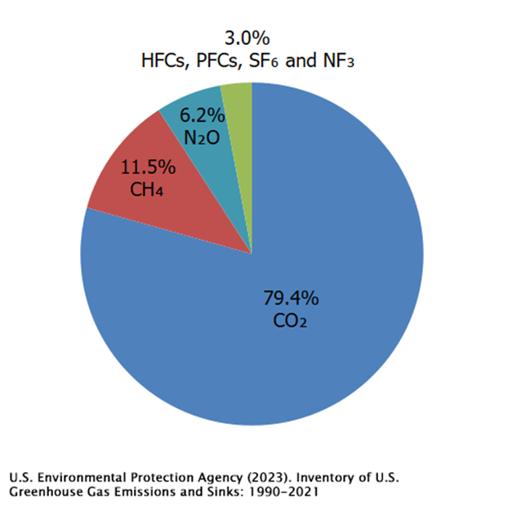
Carbon Dioxide
Emitted by industrial companies, humans, and animals
Most prominent greenhouse gas today
Absorbs infrared rays and remits heat into atmosphere

Slide 5
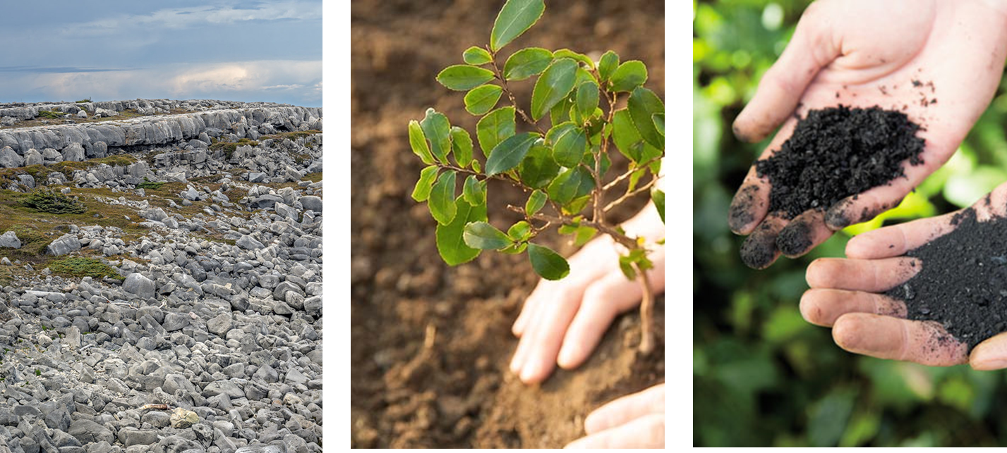
Carbon Dioxide Removal (CDR) TechnIques
Enhanced Weathering
Reforestation
Biochar

Slide 6
Where should we implement CDR Technologies?

Slide 7
Data

Slide 8
Variable | Description | Source
FIPS | FIPS code of Virginia counties | VA Gov
Income | Income per capita in given county (in dollars) | Federal Reserve
DCSI | Drought Severity and Coverage Index measures drought level, possible values from 0 to 500, ranging from no drought to exceptional drought. | Drought Monitor
PQ1-PQ4 | Average precipitation for a given county (inches). Number represents the quarter, Q1 (Jan-Mar) through Q4 (Oct-Dec). | NOAA
TQ1-TQ4 | Average temperature for a given county (Fahrenheit). Number represents the quarter, Q1 (Jan-Mar) through Q4 (Oct-Dec). | NOAA
Forest | Forest cover in a given county. | MRLC
Agriculture | Percent of land used for agriculture. | MRLC
Watershed | Indicates if a county is supplied by the Chesapeake Watershed. (Yes: 1; No: 0) | VA Gov
Biomass | Total biomass for a given county. | UVA EI
Power | Net renewable energy production in a given county. | UVA EI
Water Availability | Surface water level estimates for a given county. | UVA EI
Notes:
Could use a slide explaining the SL approach. What were the predictors? Target variable? What is the rationale for using SL?
these GGR technologies have not been deployed globally and

Slide 9
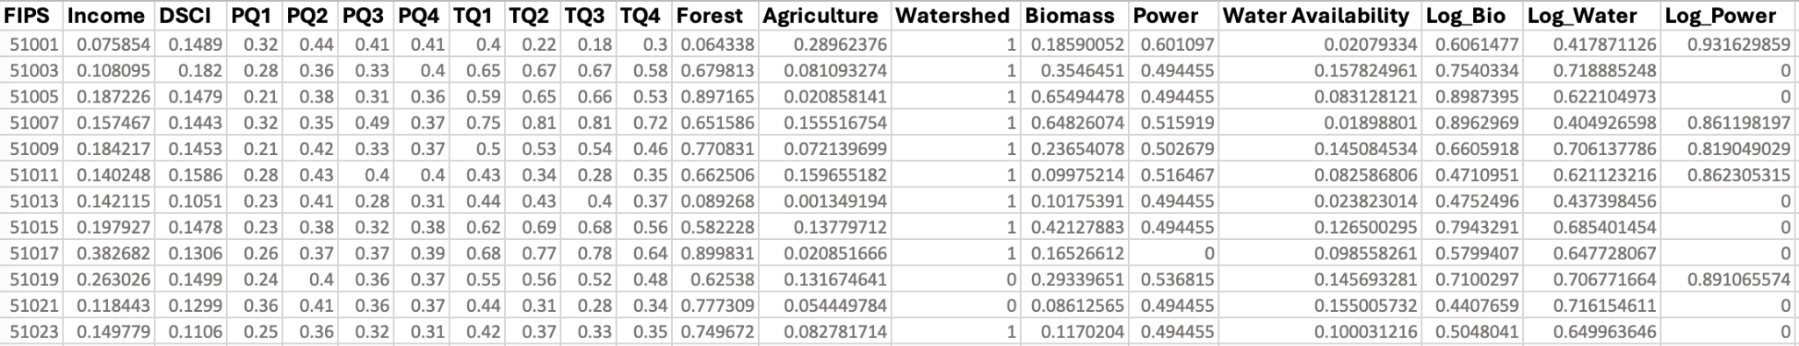
Data Preprocessing
Log Scaling
Min Max Scaling (0-1)
Notes:
Sources of data:
- temp and precip: NOAA
- income: federal reserve
- dcsi: drought monitor
- forest/agriculture: MRLC
- biomass/water availability/power: UVA EI

Slide 10
Unsupervised Learning

Slide 11
UnSupervised Learning Approach
Why Unsupervised Learning?
We needed a labeled dataset to train predictive models with, but such labels were not available
By utilizing unsupervised hierarchical clustering, we could generate clusters for our preprocessed data to label manually based on our research
The goal was to derive the output: deployment suitability for the 3 CDR techniques for each county in the training set
Unsupervised ML allowed us to identify patterns and similarities across VA counties without setting human-defined cut-off levels
Notes:
Could use a slide explaining the SL approach. What were the predictors? Target variable? What is the rationale for using SL?
these GGR technologies have not been deployed globally and

Slide 12
Unsupervised Learning
Referencing AsIBOR Et Al. 2023
Agglomerative Clustering was used to recursively merge counties together to minimize the sum of squared differences within all clusters of counties. Utilized euclidean distance metric to compare variables necessary for each CDR strategy as listed below.
Reforestation: Temperature, Precipitation, Forest Land, Water Availability
Enhanced Weathering (EW): Energy, Income, Temperature, Precipitation, Agriculture
Biochar: Biomass Availability, Temperature, Precipitation, Income, Agriculture
Four labeled clusters: highly suitable, suitable, possible, and unsuitable
Notes:
The AgglomerativeClustering object performs a hierarchical clustering using a bottom up approach: each observation starts in its own cluster, and clusters are successively merged together. The linkage criteria determines the metric used for the merge strategy
Ward minimizes the sum of squared differences within all clusters. It is a variance-minimizing approach and in this sense is similar to the k-means objective function but tackled with an agglomerative hierarchical approach.

Slide 13
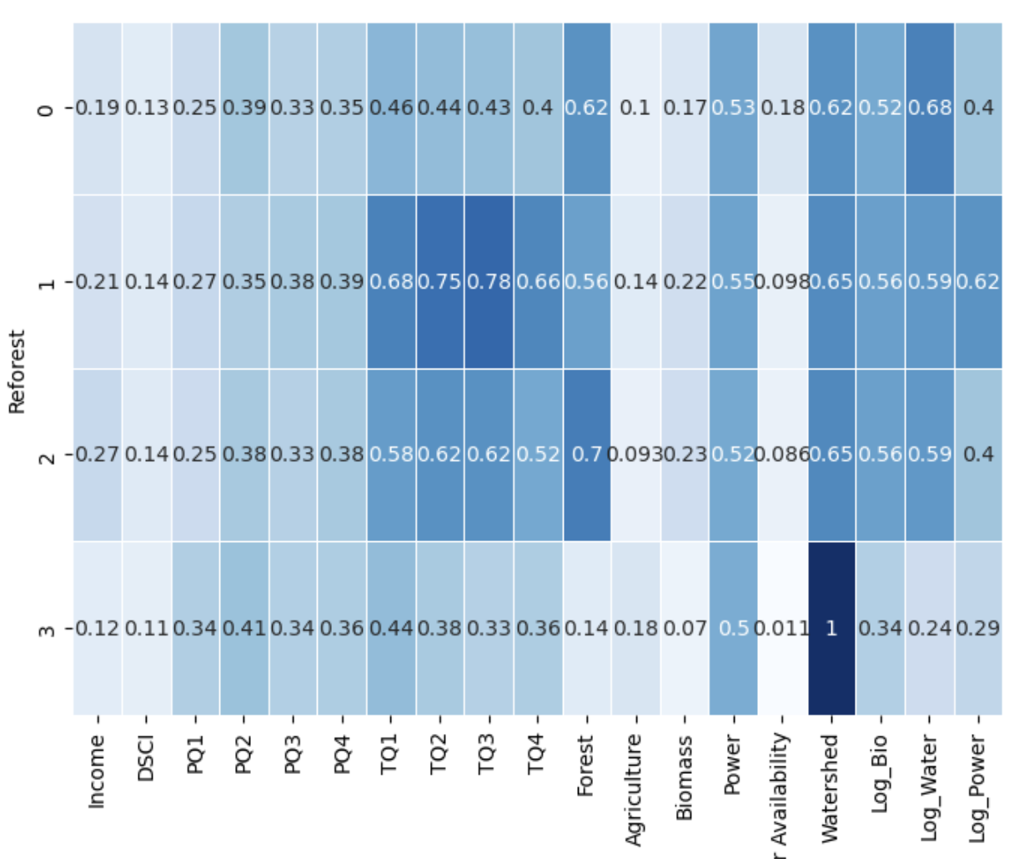
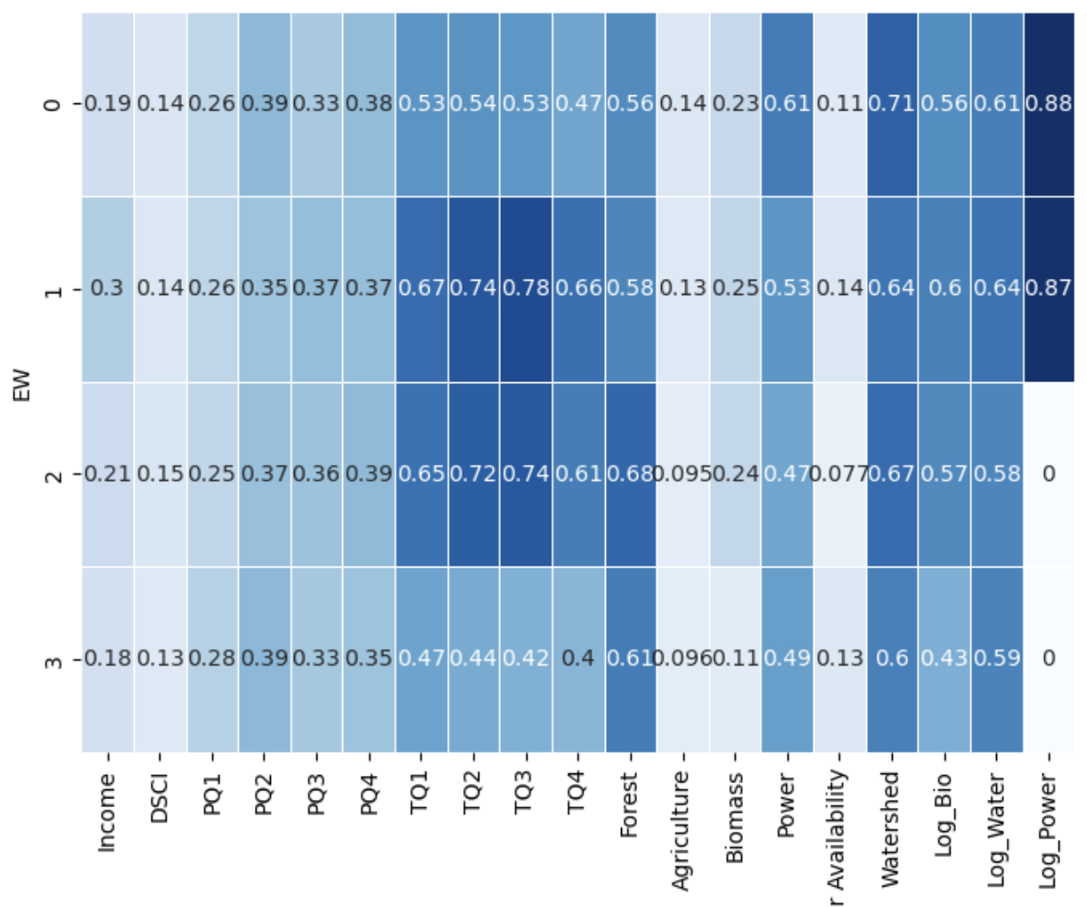
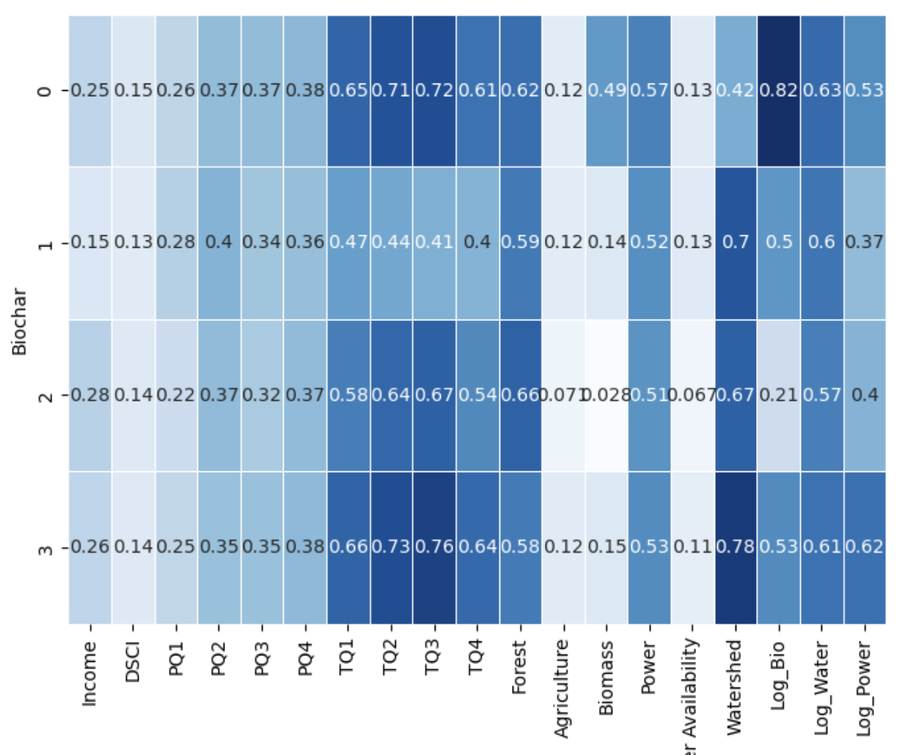
Suitability Clusters
Reforestation
0: Suitable
1: Possible
2: Highly Suitable
3: Unsuitable
Enhanced Weathering
0: Highly Suitable
1: Suitable
2: Unsuitable
3: Possible
Biochar
0: Highly Suitable
1: Possible
2: Unsuitable
3: Suitable
*highlighted columns represent variables used for labeling clusters
Notes:
discuss how you arrived at clusters based on selected variables

Slide 14
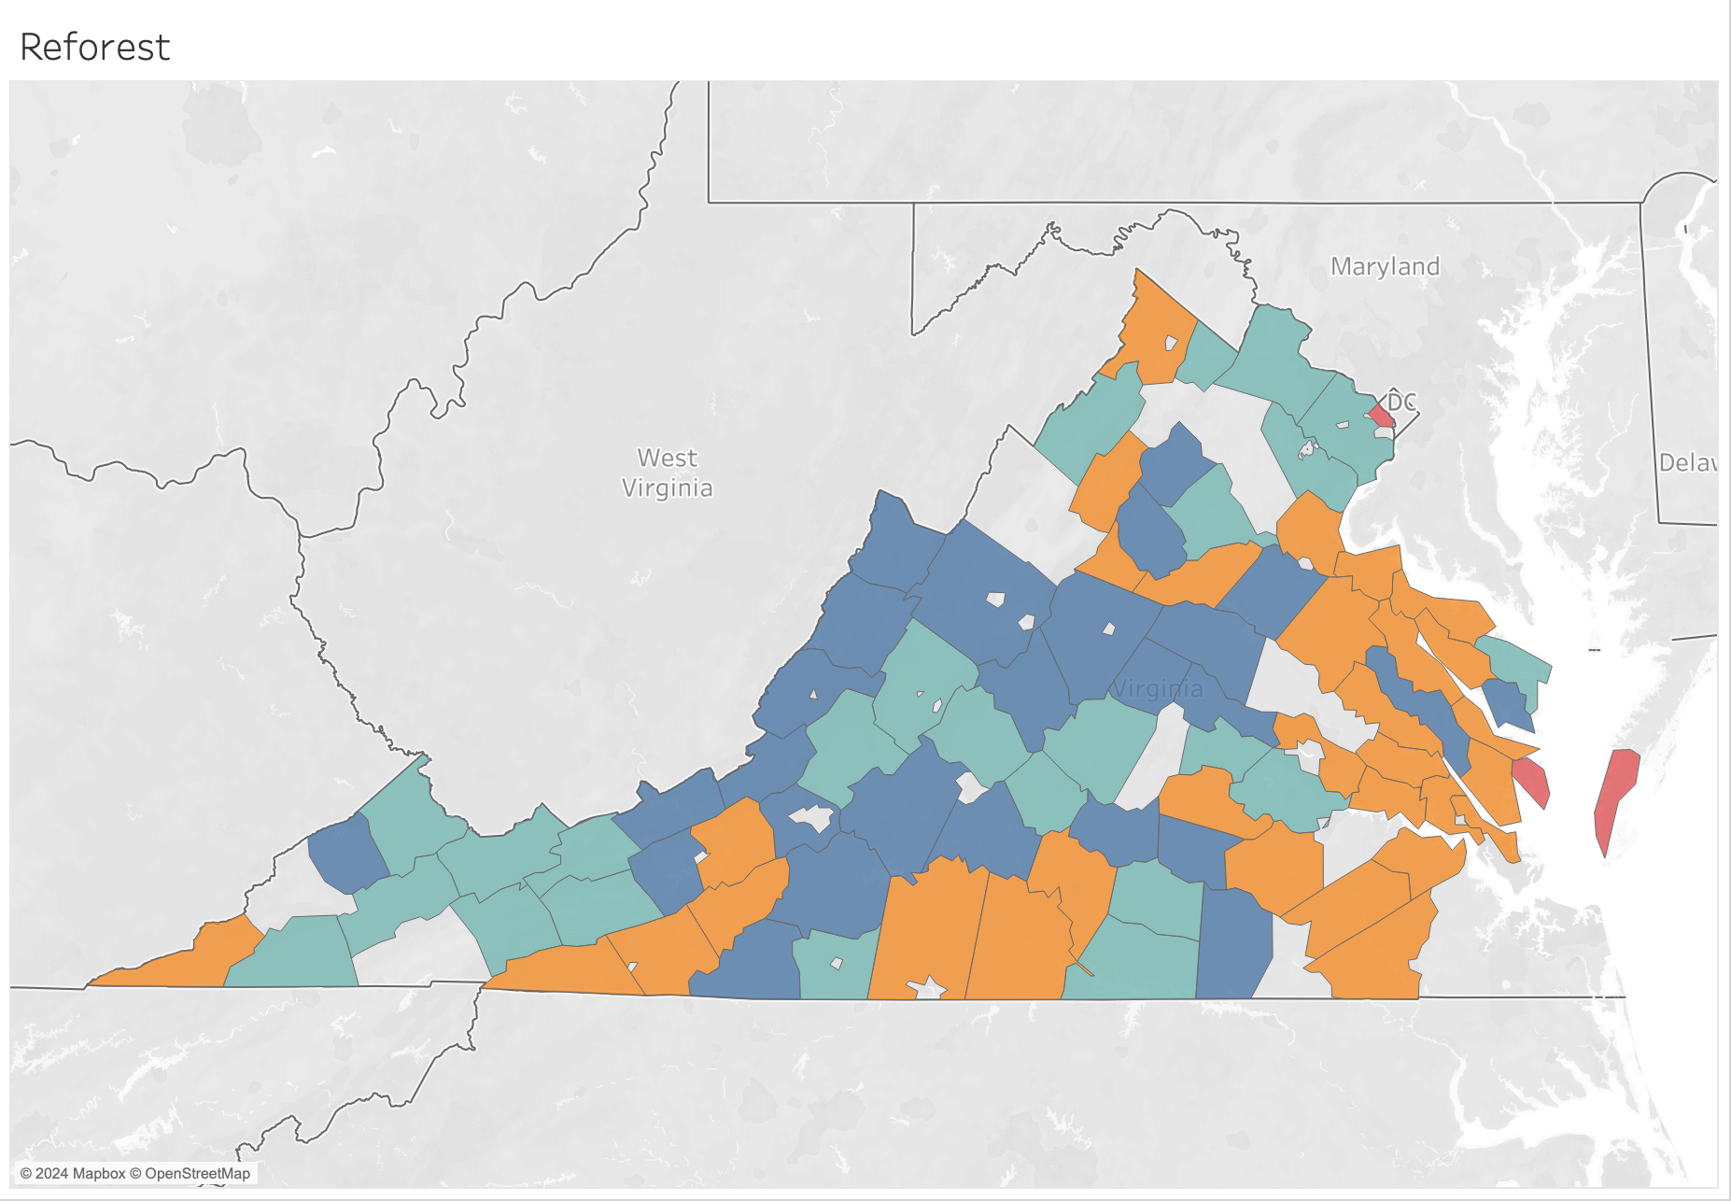
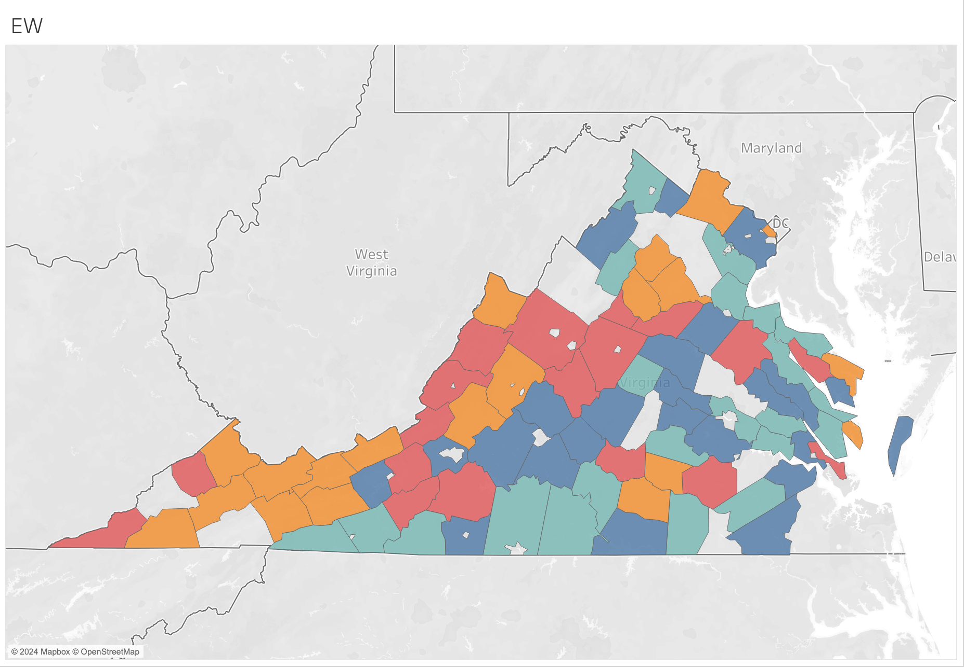
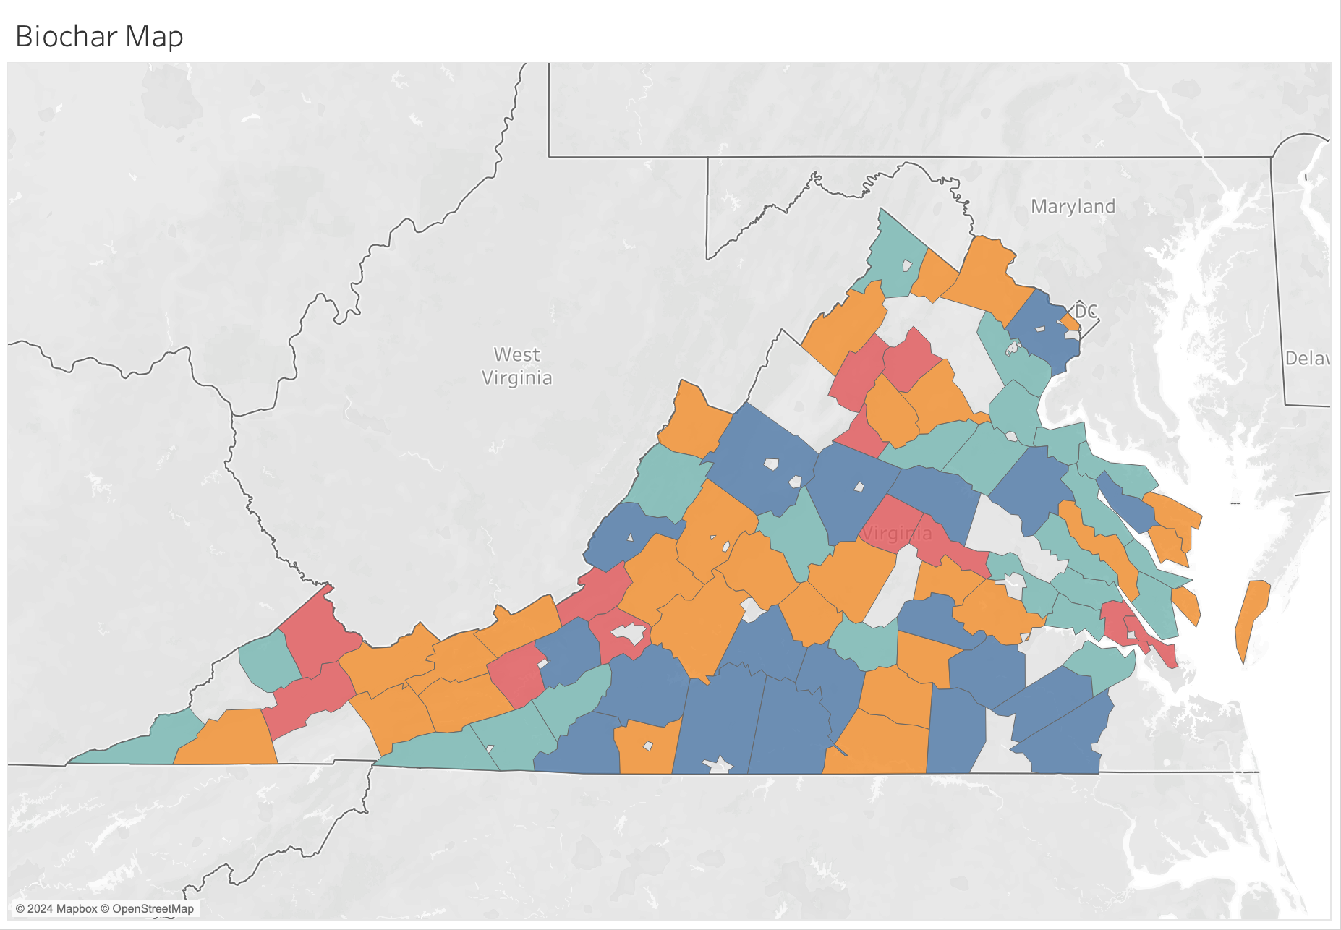
Suitability
Clusters
(Spatially)
Reforestation:
EW:
Highly Suitable
Suitable
Possible
Unsuitable
Biochar:

Slide 15
Supervised Learning

Slide 16
Train/Test/Validate Split
Validation: 6 counties of interest (withheld from clustering and modeling)
Train: 67 counties (80% of data apart from validation)
Test: 17 counties (20% of data apart from validation)
Reforestation
Cluster Distribution
Enhanced Weathering
Cluster Distribution
Biochar
Cluster Distribution
 | Train | Test
Highly Suitable | 22 | 4
Suitable | 19 | 5
Possible | 23 | 8
Unsuitable | 3 | 0
 | Train | Test
Highly Suitable | 19 | 5
Suitable | 15 | 7
Possible | 17 | 3
Unsuitable | 16 | 2
 | Train | Test
Highly Suitable | 18 | 1
Suitable | 15 | 8
Possible | 25 | 5
Unsuitable | 9 | 3
Notes:
Note from Adam:
Later you'll report accuracy. Be sure to explain what that means in this case.
You predict suitability level for each county and see if it matches the cluster.
If the county was assigned to the wrong cluster, SL will likely get it wrong. So there can be two sources of error: assigning county to the wrong cluster, and predicting the wrong cluster with SL.
This is why it is good to check some of the predictions that were incorrect to see where the error is happening.

Slide 17
Supervised Learning (SL) Approach
We chose to use SL to assess the suitability of the CDR methods without human bias.
Similarly to our clustering approach, we generated SL models using the variables necessary for each CDR method as the predictors. This avoids overfitting and proved to be more accurate than using all our variables as predictors.
Reforestation: Temperature, Precipitation, Forest Land, Water Availability
Enhanced Weathering (EW): Energy, Income, Temperature, Precipitation, Agriculture
Biochar: Biomass Availability, Temperature, Precipitation, Income, Agriculture
Target variable: Suitability level generated previously

Slide 18
SL Model accuracies (Percent of correctly classified Counties)
Reforestation
Random Forest: 0.882
Logistic Regression: 0.941
Decision Tree: 0.882
KNN: 0.941
Naive Bayes: 0.647
Gradient Boost: 0.882
MLPClassifier: 0.941
ANN: 0.882
Enhanced Weathering
Random Forest: 1.0
Logistic Regression: 1.0
Decision Tree: 0.882
KNN: 1.0
Naive Bayes: 0.588
Gradient Boost: 0.882
MLPClassifier: 0.941
ANN: 0.941
Biochar
Random Forest: 1.0
Logistic Regression: 0.941
Decision Tree: 0.824
KNN: 1.0
Naive Bayes: 0.294
Gradient Boost: 1.0
MLPClassifier: 1.0
ANN: 0.882
*best models per technique measured on test set

Slide 19
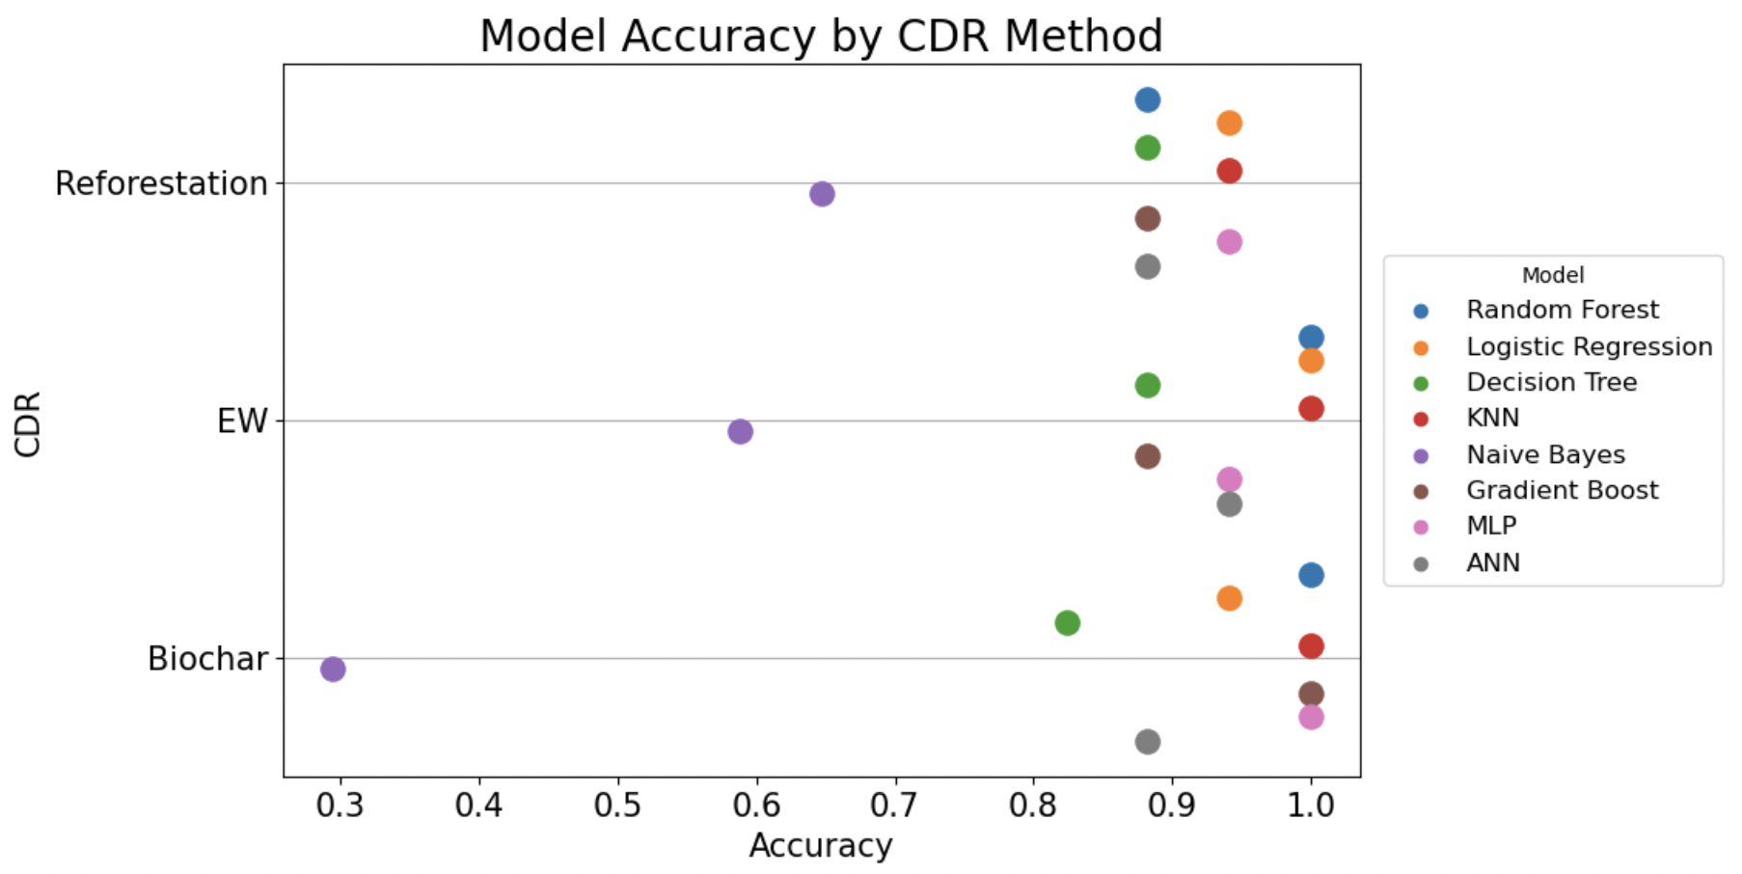
Supervised Ml Accuracies
*percent of correctly classified counties in the test set

Slide 20
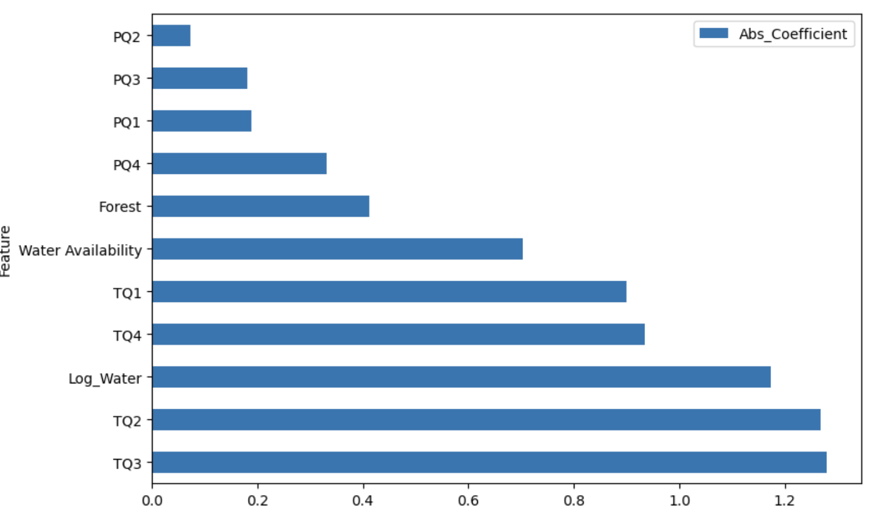
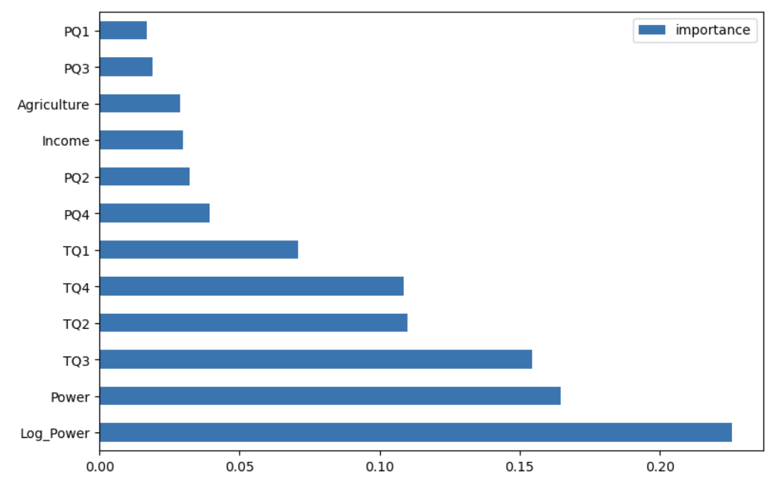
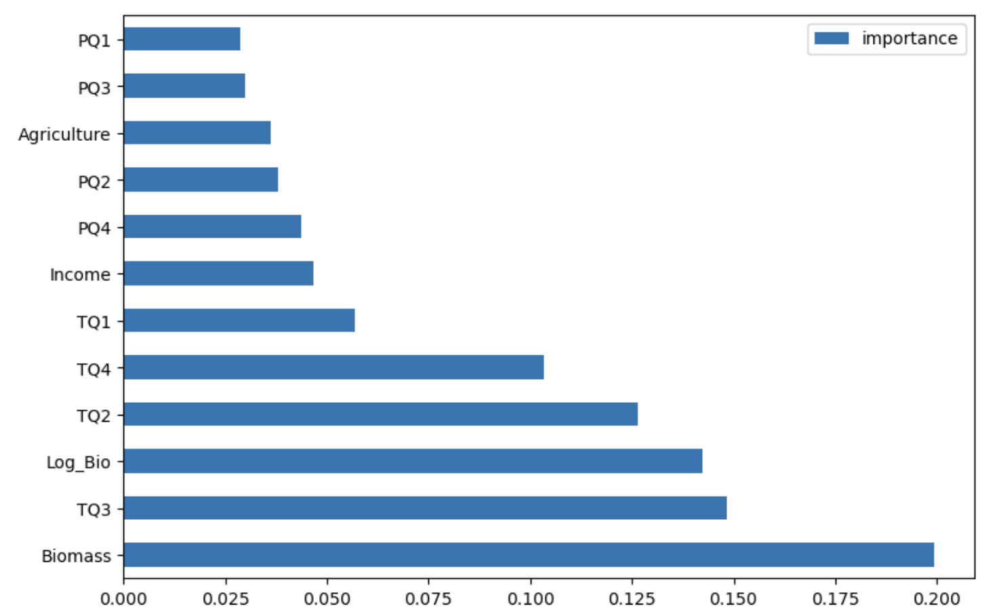
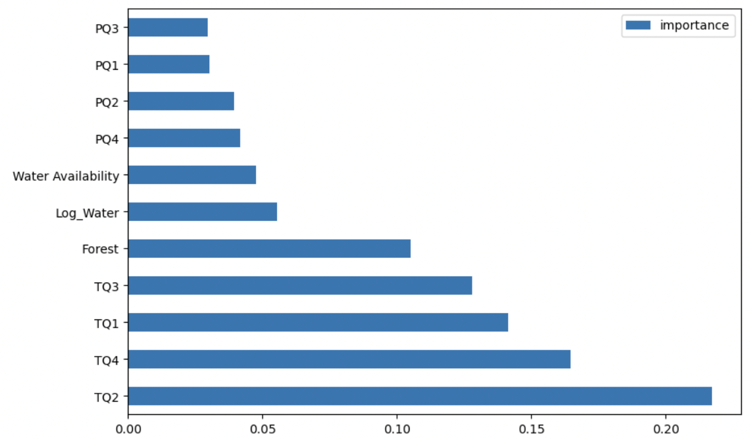
Variable Importance by CO2 removal Technique
Reforestation Enhanced Weathering Biochar
Temperature and Forest Land are most important
Power and Temperature are most important
Biomass and Temperature are most important
The lesser important variables were found to be Precipitation, Water Availability, Agriculture Land, and Income
*importance scores from Random Forest models

Slide 21
Case Study

Slide 22
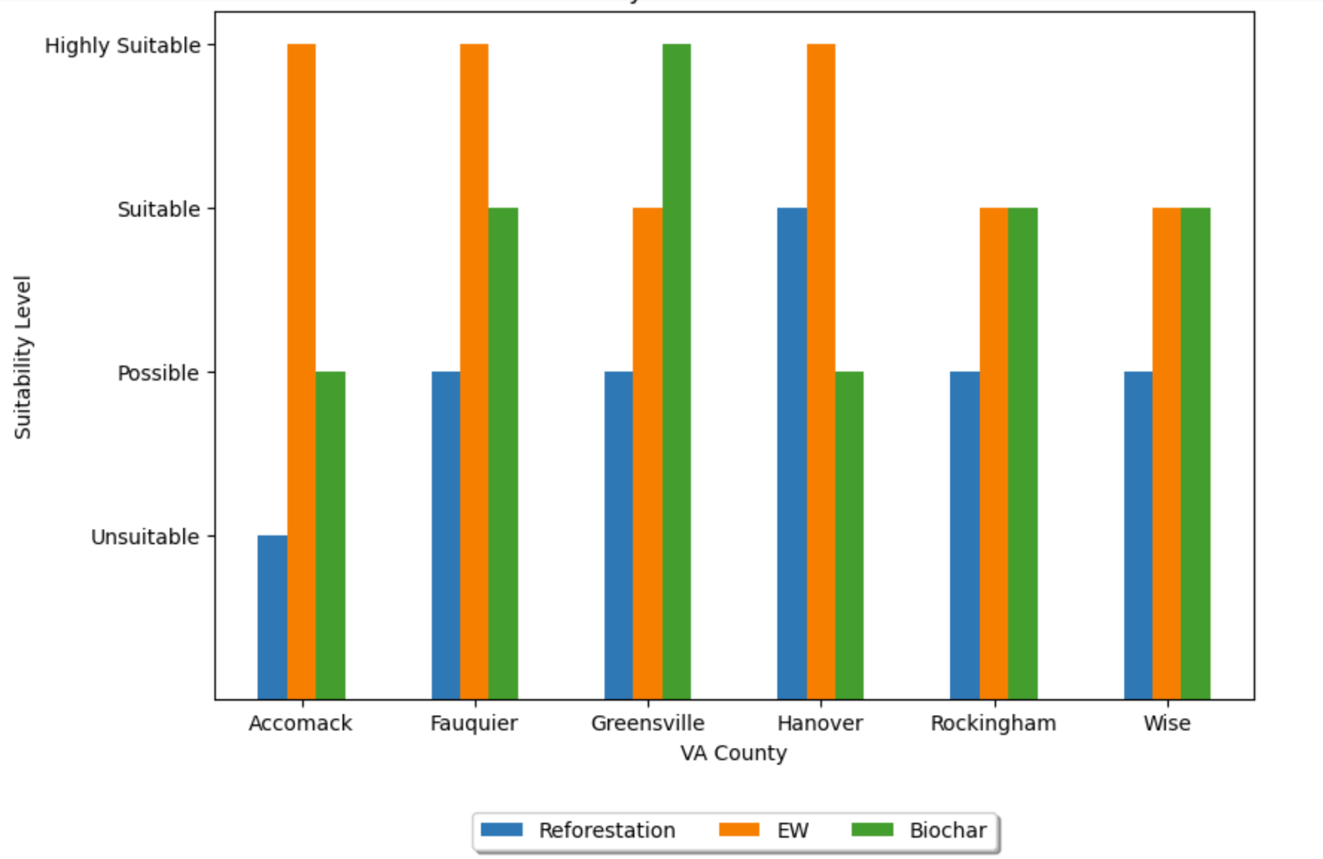
Suitability Levels for Validation Set
Notes:
Assess performance accuracy

Slide 23
Best Areas for CDR Techniques
EW: eastern VA
VA Coastal Plain - exposure to rapid weathering
Biochar: southern border of VA shows patterns of being most suitable
Reforestation: none labeled as highly suitable, but Hanover is the only county categorized as suitable
Rockingham (highest forest)
Hanover neighbors Richmond and has a prominent solar mission. In their bill they promise to replace trees affected by the construction of solar panels

Slide 24
Conclusion

Slide 25
Conclusions & Recommendations
Study promotes more efficient implementation of these costly technologies
Model accuracies ranged from 29-100%
KNN demonstrated the highest accuracy for all technologies
Assessed model performance on validation set (6 counties of interest)
Limitations
Underfitting due to small dataset (90 counties)
Exclusion of Virginia cities because of inconsistent data availability online
Notes:
Lily - to do

Slide 26



Acknowledgements
Adam Tashman
(Faculty Mentor)
Majid Shafiee-Jood
(Sponsor)
Andrés Clarens
(Sponsor)

Slide 27




Capstone team
Rachel Holman
Lily Jarrett
Grace Davenport
Hana Nur

Slide 28
Thank you!
Any questions?

Slide 29
References
[1] Asibor, J. O., Clough, P. T., Nabavi, S. A., & Manovic, V. (2023). A machine learning approach for resource mapping analysis of greenhouse gas removal technologies. Energy and Climate Change, 4, 100112. https://doi.org/10.1016/j.egycc.2023.100112
[2] Biomass Energy in Virginia. (n.d.). http://www.virginiaplaces.org/energy/biomass.html
[3] Favero, A., Sohngen, B., Huang, Y., & Jin, Y. (2018). Global cost estimates of forest climate mitigation with albedo: A new integrative policy approach. Environmental Research Letters, 13(12), 125002. https://doi.org/10.1088/1748-9326/aaeaa2
[4] Fuss, S., et al. (2018). Negative emissions—Part 2: Costs, potentials and side effects. Environmental Research Letters, 13(6), 063002. https://doi.org/10.1088/1748-9326/aabf9f
[5] Lashof, D. A., & Ahuja, D. R. (1990). Relative contributions of greenhouse gas emissions to global warming. Nature, 344(6266), 529–531. https://doi.org/10.1038/344529a0
[6] Rocks of the Coastal Plain. Earth@Home. (2023, September 20). https://earthathome.org/hoe/se/rocks-cp/
[7] Schuiling, R. D., & Krijgsman, P. (2006). Enhanced Weathering: An Effective and Cheap Tool to Sequester Co2. Climatic Change, 74(1–3), 349–354. https://doi.org/10.1007/s10584-005-3485-y
[8] Smith P. (2016). Soil carbon sequestration and biochar as negative emission technologies. Glob Chang Biol. 22(3):1315-24. doi: 10.1111/gcb.13178.
[9] Smith, P., et al. (2016). Biophysical and economic limits to negative CO2 emissions. Nature Climate Change, 6(1), 42–50. https://doi.org/10.1038/nclimate2870
[10]Solar policy: Hanover County, VA. Solar Policy | Hanover County, VA. (n.d.). https://www.hanovercounty.gov/1301/Solar-Policy
[11]Strefler, J., Amann, T., Bauer, N., Kriegler, E., & Hartmann, J. (2018). Potential and costs of carbon dioxide removal by enhanced weathering of rocks. Environmental Research Letters, 13(3), 034010. https://doi.org/10.1088/1748-9326/aaa9c4
[12] Sweeney, C., et al. (2015). Seasonal climatology of CO 2 across North America from aircraft measurements in the NOAA/ESRL Global Greenhouse Gas Reference Network. Journal of Geophysical Research: Atmospheres, 120(10), 5155–5190. https://doi.org/10.1002/2014JD022591
[13]Wang, J., & Wang, S. (2019). Preparation, modification and environmental application of biochar: A review. Journal of Cleaner Production, 227, 1002–1022. https://doi.org/10.1016/j.jclepro.2019.04.282

